Slide 1
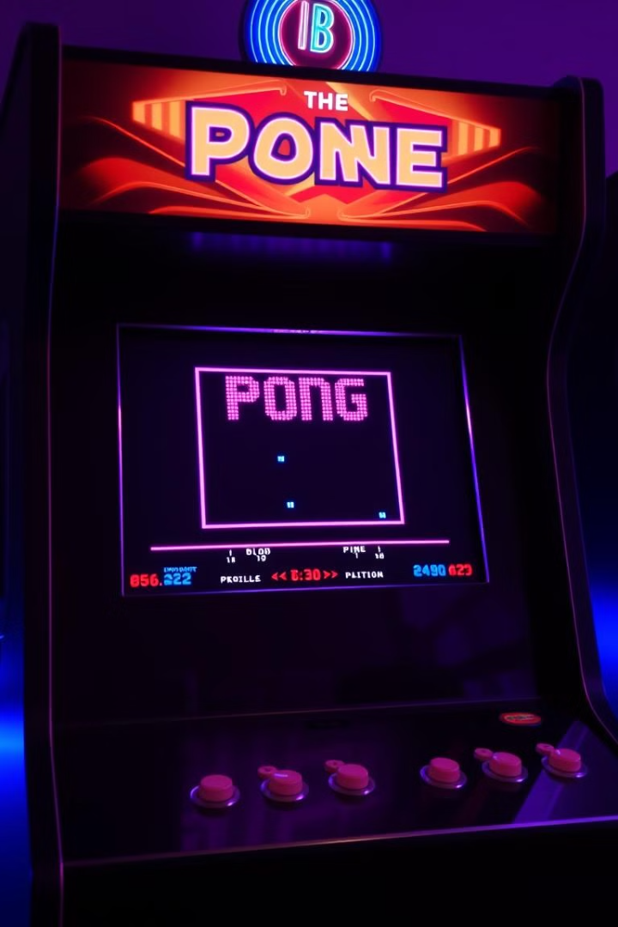
Ping Pong Game
This presentation will explain how to write a simple Pong game using the Pygame library in Python. We'll explore the key code sections, including setup, game logic, and ball movement, guiding you through the process of creating your own classic Pong game.
By,
Alwyn barnabas daniels

Slide 2
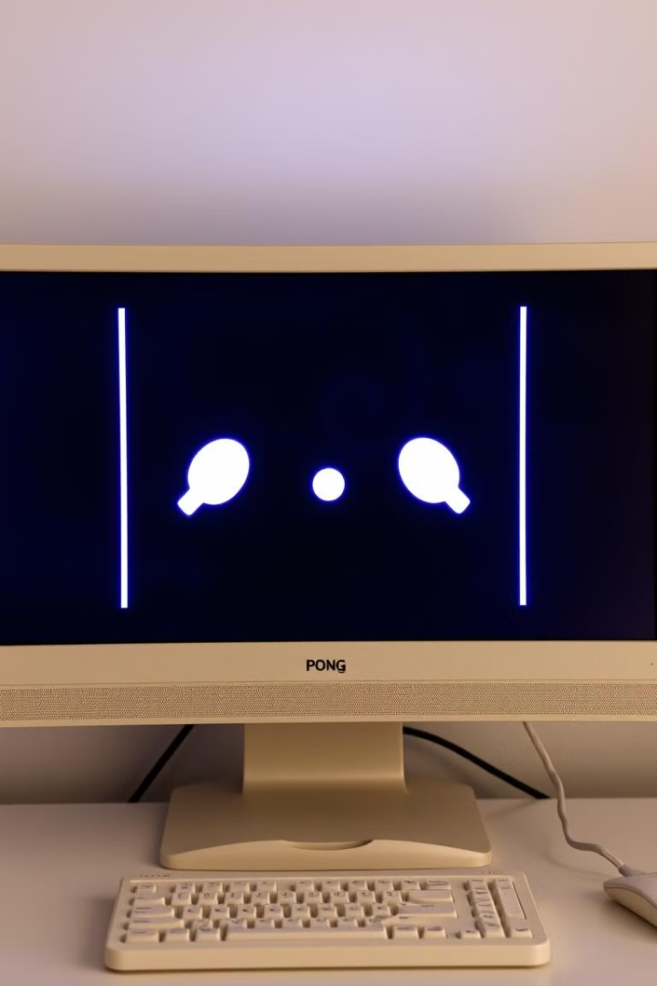
Game Initialization and Setup
Import Libraries
Initialize Pygame
Start by importing the necessary libraries, including pygame for graphics and sound, and random for generating random numbers.
Initialize Pygame by calling pygame.init(). This sets up the necessary modules for the game.
Set Up the Screen
Define Colors
Define the dimensions of the game window and create a display surface using pygame.display.set_mode().
Define the colors you'll use in the game, such as white for the paddles and ball, and black for the background.

Slide 3
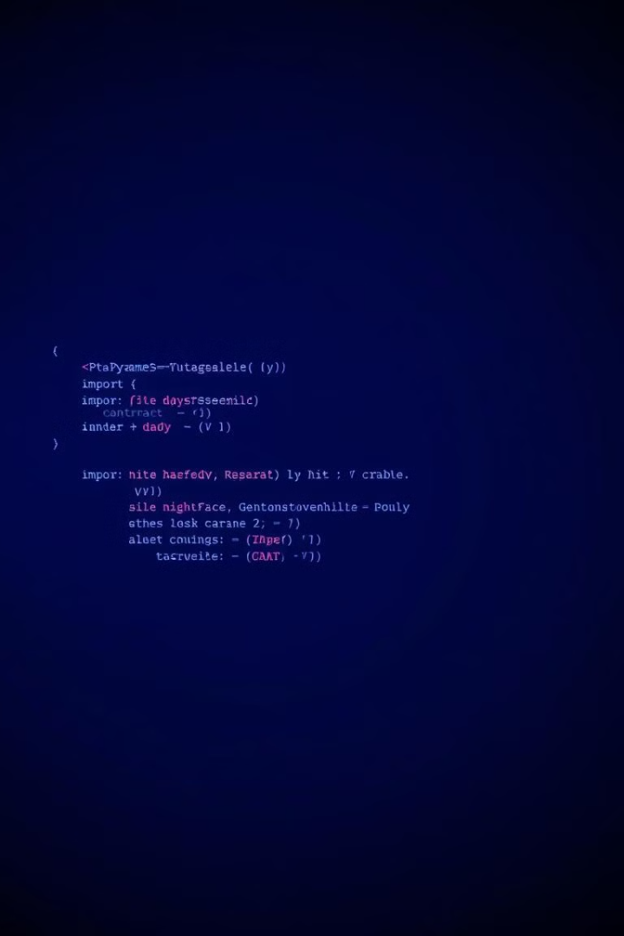
Game Setup and Initialization
import pygame import random # Initialize pygame pygame.init()
The code begins by importing the Pygame library and the random module. The pygame.init() function initializes the Pygame library, preparing it for use. This step is crucial for setting up all the Pygame modules needed for the game.

Slide 4
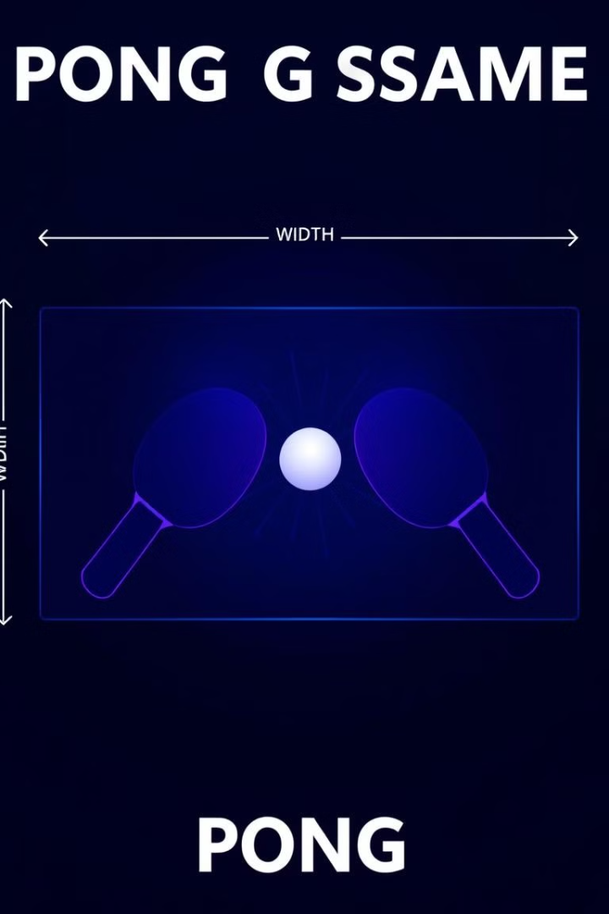
Game Constants and Dimensions
# Game constants WIDTH, HEIGHT = 800, 600 FPS = 60 PADDLE_WIDTH, PADDLE_HEIGHT = 10, 100 BALL_SIZE = 15 WHITE = (255, 255, 255) BLACK = (0, 0, 0) PADDLE_SPEED = 10
These lines define the constants for the game's dimensions, such as the screen width and height, and the size of the paddles and ball. They also define the colors used for the game elements (White and Black) and the speed at which the paddles move.

Slide 5
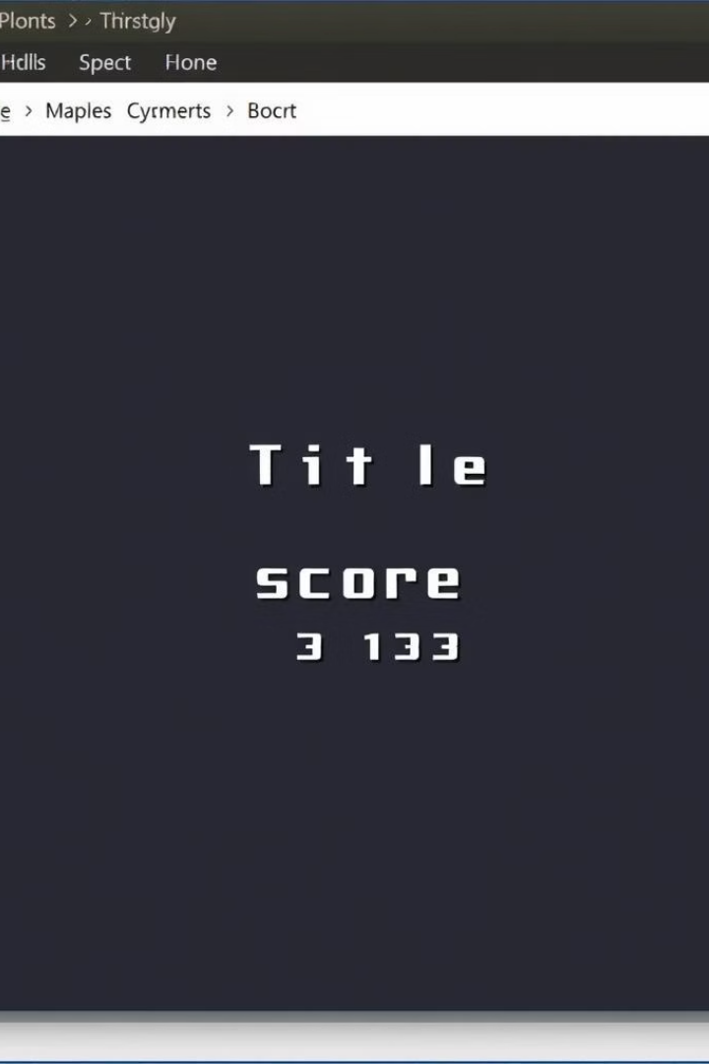
Creating the Game Screen
# Setup screen and clock screen = pygame.display.set_mode((WIDTH, HEIGHT)) pygame.display.set_caption('Pong') clock = pygame.time.Clock()
The pygame.display.set_mode() function creates the game window using the predefined width and height. The pygame.display.set_caption() function sets the title of the game window to "Pong." The pygame.time.Clock() function controls the game's frame rate, ensuring smooth gameplay.

Slide 6
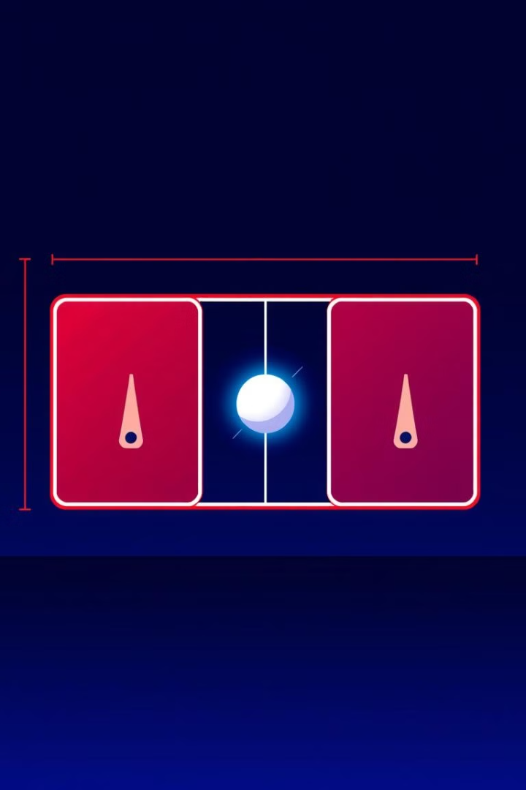
Initializing Paddles and Ball
# Paddle and Ball positions paddle1 = pygame.Rect(10, HEIGHT//2 - PADDLE_HEIGHT//2, PADDLE_WIDTH, PADDLE_HEIGHT) paddle2 = pygame.Rect(WIDTH - 20, HEIGHT//2 - PADDLE_HEIGHT//2, PADDLE_WIDTH, PADDLE_HEIGHT) ball = pygame.Rect(WIDTH//2 - BALL_SIZE//2, HEIGHT//2 - BALL_SIZE//2, BALL_SIZE, BALL_SIZE)
These lines use pygame.Rect() to create rectangular objects representing the paddles and ball. Each rectangle is defined by its position (top-left corner x, y) and its width and height. The paddles are placed on opposite sides of the screen, and the ball is positioned at the center of the screen.

Slide 7
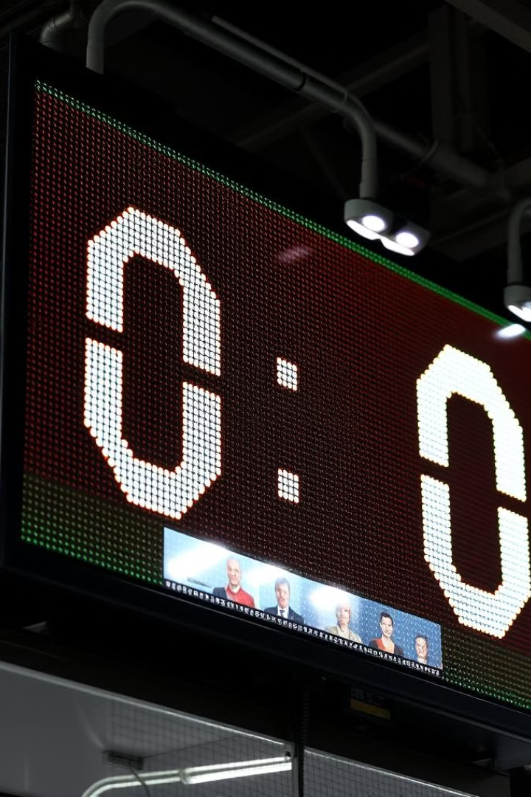
Ball Speed and Scoring
# Ball speed variables ball_speed = [random.choice([-4, 4]), random.choice([-4, 4])] ball_speed_increment = 0.5 # Speed increment after each score # Scores score1, score2 = 0, 0
The ball's initial speed is randomized using random.choice(), giving it a random horizontal and vertical direction. The ball_speed_increment variable defines how much the ball's speed increases after each score. The variables score1 and score2 keep track of the scores for each player, starting at 0.

Slide 8

Main Game Loop: The Heartbeat of Your Game
# Game loop while True: for event in pygame.event.get(): if event.type == pygame.QUIT: pygame.quit()
The game runs in an infinite loop. It continuously updates the display, handles user input, and processes game logic.

Slide 9
Paddle Movement: Player Control
Player 1
Player 2
if keys[pygame.K_w] and paddle1.top > 0: paddle1.y -= PADDLE_SPEED if keys[pygame.K_s] and paddle1.bottom < HEIGHT: paddle1.y += PADDLE_SPEED
if keys[pygame.K_UP] and paddle2.top > 0: paddle2.y -= PADDLE_SPEED if keys[pygame.K_DOWN] and paddle2.bottom < HEIGHT: paddle2.y += PADDLE_SPEED
Each player controls their paddle. Boundary checks ensure paddles stay within the screen's limits.

Slide 10
Ball Movement and Collision Detection
Ball Movement
Collision Detection
ball.x += ball_speed[0] ball.y += ball_speed[1]
if ball.top <= 0 or ball.bottom >= HEIGHT: ball_speed[1] = -ball_speed[1] if ball.colliderect(paddle1) or ball.colliderect(paddle2): ball_speed[0] = -ball_speed[0]
The ball's position is updated based on its speed. Collisions with walls and paddles reverse the ball's direction.

Slide 11
Scoring and Resetting the Ball
Scoring
Resetting the Ball
The `reset_ball` function places the ball back in the center and increases its speed.
if ball.left <= 0: reset_ball("player2") if ball.right >= WIDTH: reset_ball("player1")
When the ball goes out of bounds, the other player scores a point. The `reset_ball` function resets the ball's position and increases the ball speed for a more challenging game.

Slide 12
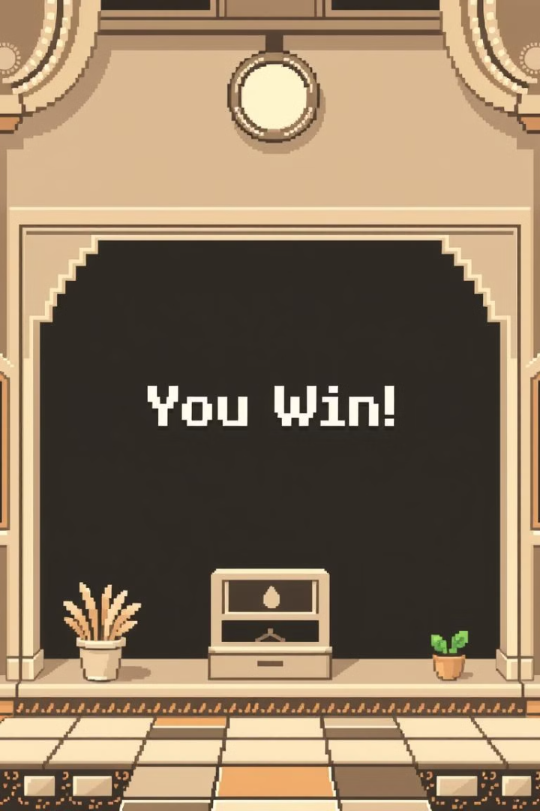
Winning Condition: Game Over!
# Check for win condition if score1 >= 5 or score2 >= 5: winner_text = "Player 1 Wins!" if score1 >= 5 else "Player 2 Wins!" winner_surface = font.render(winner_text, True, WHITE) screen.blit(winner_surface, (WIDTH//2 - winner_surface.get_width()//2, HEIGHT//2)) pygame.display.update() pygame.time.delay(2000) score1, score2 = 0, 0 # Reset the game pygame.time.delay(500)
The game ends when either player reaches 5 points. A win message is displayed, and the game resets after a short delay.

Slide 13
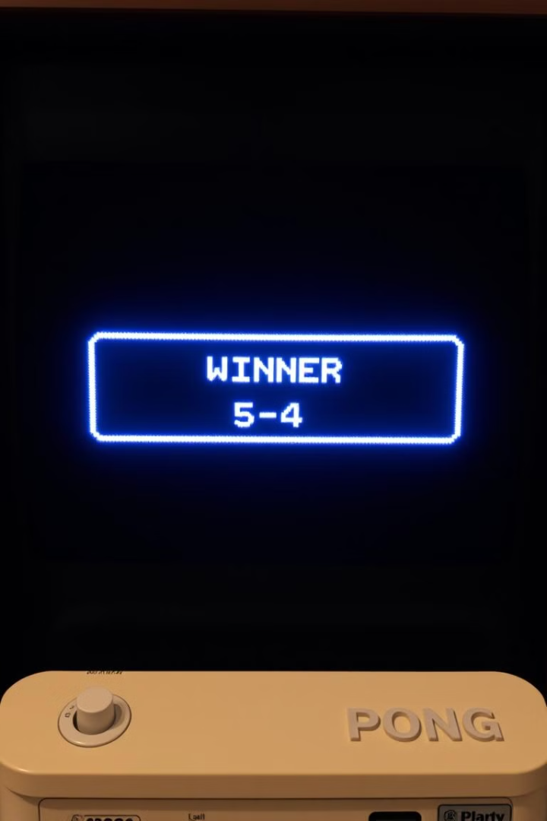
Win Condition and Restart
# Check for win condition if score1 >= 5 or score2 >= 5: winner_text = "Player 1 Wins!" if score1 >= 5 else "Player 2 Wins!" winner_surface = font.render(winner_text, True, WHITE) screen.blit(winner_surface, (WIDTH//2 - winner_surface.get_width()//2, HEIGHT//2)) pygame.display.update() pygame.time.delay(2000) score1, score2 = 0, 0 # Reset the game pygame.time.delay(500)
Win Condition
The game ends when either player reaches 5 points. A message appears at the center of the screen announcing the winner. After a short delay, the scores reset, and the game starts over.

Slide 14

Conclusion
1
Summary
2
Key Concepts
This code demonstrates the creation of a simple Pong game using pygame with basic game mechanics like paddle movement, ball bounce, collision detection, scoring, and a win condition.
Handling user input, updating positions, detecting collisions, and implementing game loops.

